Slide 1
Retail Pricing

Slide 2
Questions
What factors do retailers consider when pricing merchandise?
What are the legal restrictions on retail pricing?
How do retailers set retail prices?
How do retailers make adjustments to prices over time and for different market segments?
Why do some retailers have frequent sales while others attempt to maintain an everyday-low-price strategy?
What pricing tactics do retailers use to influence consumer purchases?

Slide 3
Why pricing important ?
Pricing decision is important because customers have alternatives to choose from and are better informed
Customers are in a position to seek good value
Value = perceived benefits
price
So, retailers can increase value and stimulate sales by increasing benefits or reducing price.

Slide 4
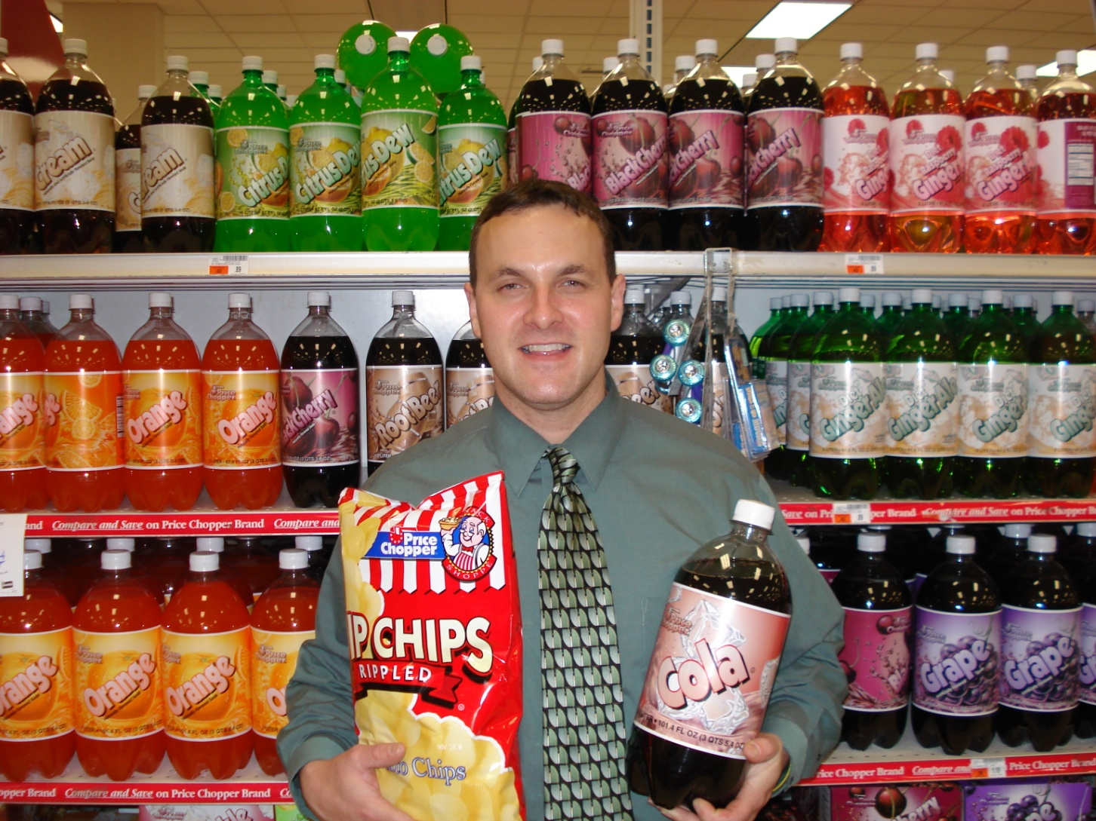
Retailers Use Private Label Products to Increase Value

Slide 5
Customer Price sensitivity and Cost
Relationship between Price Sensitivity and Demand
When increases
can decrease
as fewer customers feel the product is a good value
Price
Sales

Slide 6
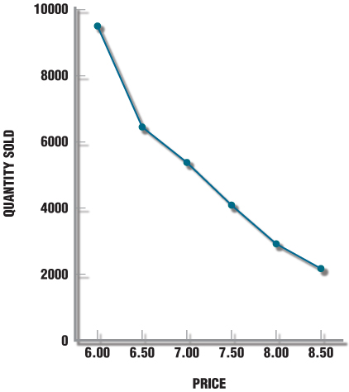
Price sensitivity of customers (demand curve)
Quantity Sold at Different Prices
If customers are very price sensitive,
Sales decrease significantly
with price increase

Slide 7
Price Elasticity
A commonly used measure of price sensitivity
Elasticity = percent change in quantity sold
percent change in price

Slide 8
Assume that a retailer originally priced a private-label DVD play at $90 and raised the price to $100. Prior to raising the price, the retailer was selling 1,500 units a week. When the price was increased, sales dropped to 1,100 units per week. What is the price elasticity of the product?

Slide 9
Price Elasticity
Elasticity = percent change in quantity sold
percent change in price
= (new quantity sold – old quantity sold)/old quantity sold
(new price – old price)/(old price)
= (1100-1500)/1500
(100-90)/90
= -0.2667
.1111
= -2.4005
Price elasticity is a negative number because the quantity sold usually Decreases when prices increase. When price elasticity is greater than - 1, the target market for a product is viewed to be price insensitive

Slide 10
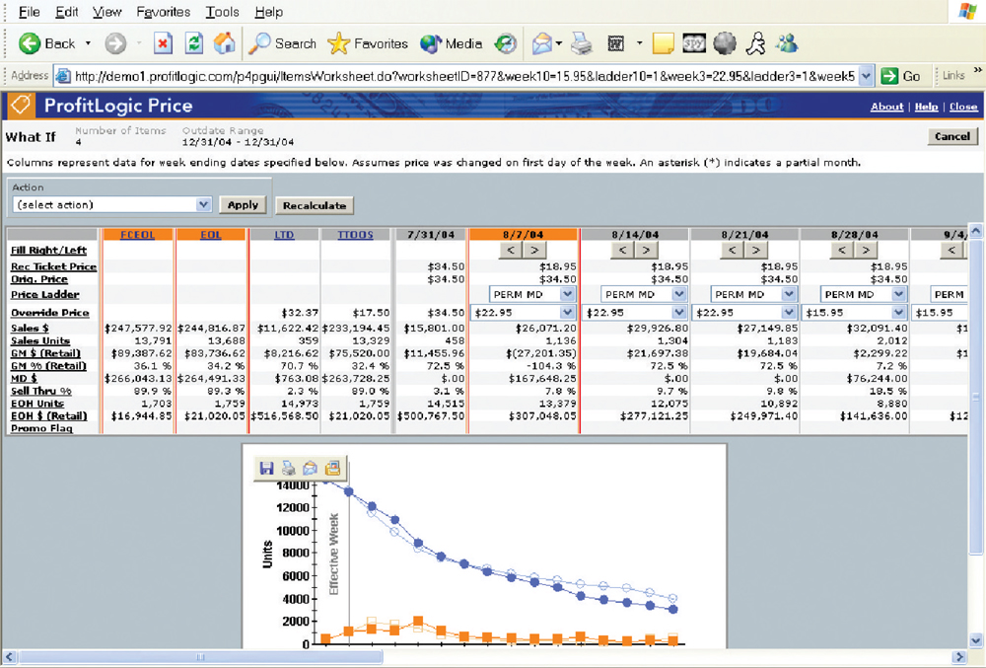
Markdown Optimization Software ProfitLogic

Slide 11

Internet and Price Competition
The Internet offers unlimited shopping experience
Seeking lowest price? Use shopping bots or search engines
These programs search for and provide lists of sites selling what interests the consumer
Retailers using the electronic channel can reduce customer emphasis on price by providing services and better information.

Slide 12
Thank You
- By,
Yashwanth

